Slide 1


3-D physics simulator
Python End- Term Project
-To Ashutosh Gupta sir

Slide 2
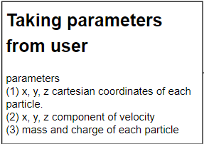
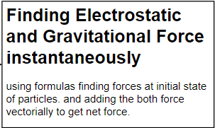
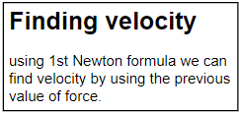
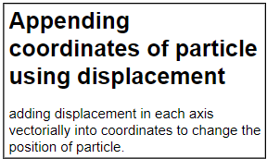
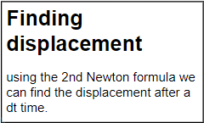
j
Fundamental Algorithm of Project
This goes for 1000 frames in a sec.
And thus we will get dynamics of each particle at any instant.

Slide 3
NumPy ----> Arrays are used to store dynamics values like KE, PE, Forces, velocity, displacement.
1-D, 2-D, 3-D and even 4-D arrays are used to store the values.
Matplotlib.pyplot ----> visualizing change of KE, PR, Forces, Velocity with changing time.
Tkinter ----> for GUI of our project (future- scope)
Modules, Libraries, Constants
3-D array
for n particles
for each frame
For 3 axis of particles

Slide 4
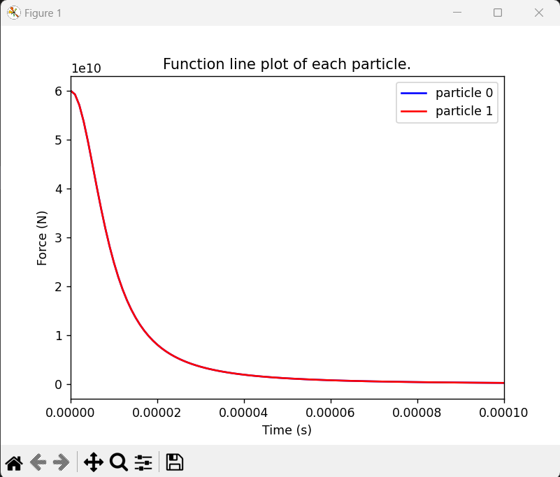
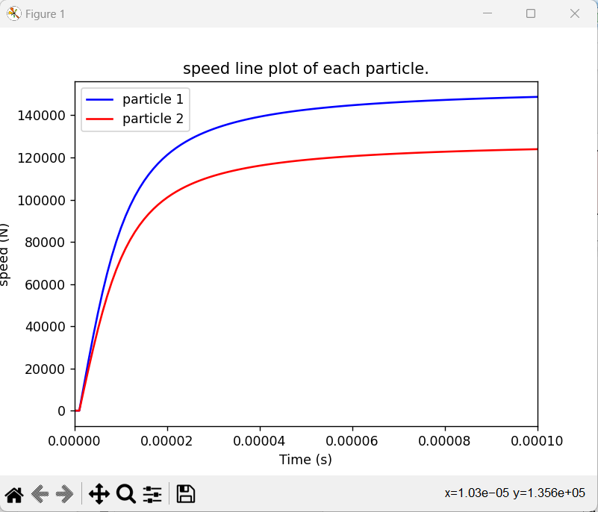
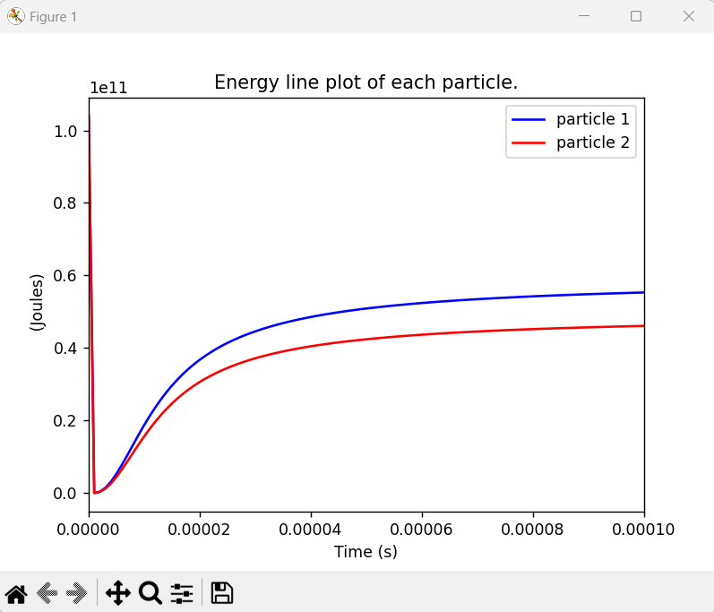
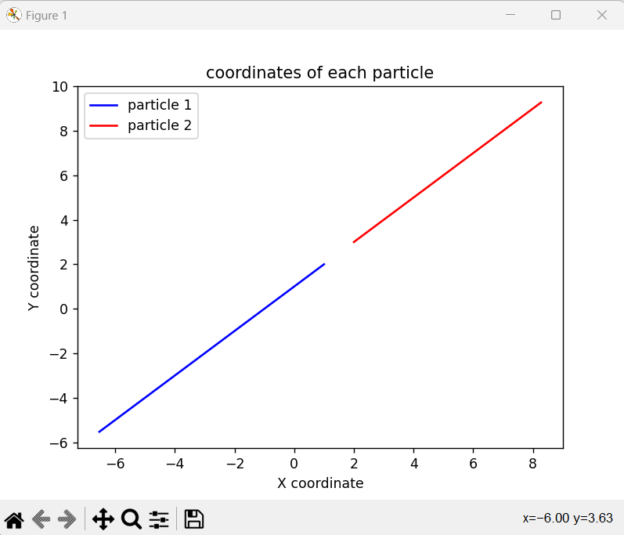
Main Content
We are calculation:-
Electrostatic, Gravitational, Total Forces
Vectorially
Net
Velocity
Speed
KE, PE (EPE, GPE), Total energy
Angular Momentum
Linear Momentum
Torque
Displacement
Trajectory

Slide 5
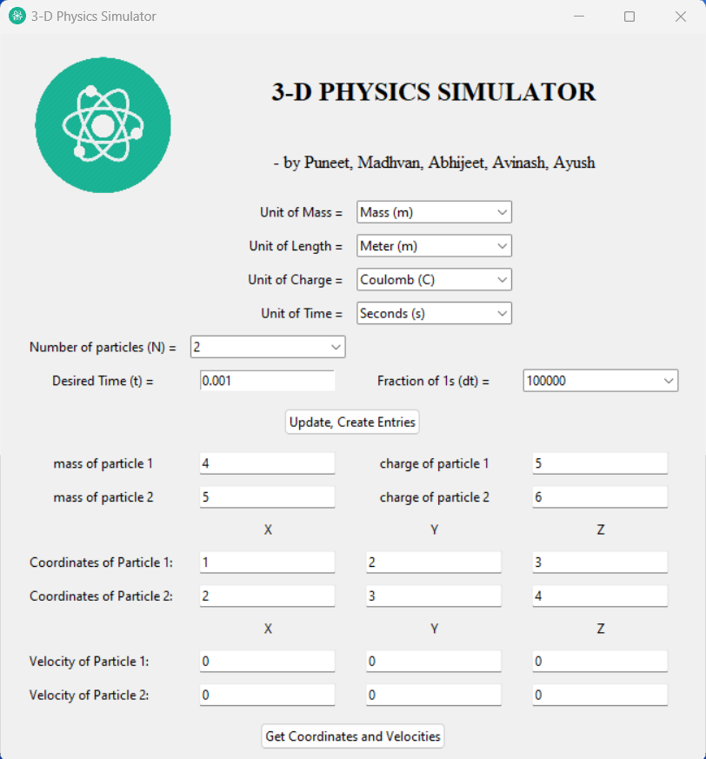
GUI (Graphical User Interface)
For GUI we have used Tkinter a library of Python. In it we have used following concepts:-
Labels
Grid
Root widget
Combo pack
Buttons
Input panels
PhotoImages
However integrating this GUI to my main project is not done yet. It will be our future scope.

Slide 6
Thank you
Puneet Dhankar Abhijeet Tiwari
23CS002726 23CS002812
A- G1 C- G2
Madhavan Bohra Avinash Chaurasiya
23CS002744 23CS002794
A- G1 C- G2
Ayush Pancholi
23CS002760
A- G2

